Slide 1





Digital Portfolio
STUDENT NAME: kirupa.R
REGISTOR NO AND NMID: 212406216/ 15F62777B634AFCB09645499CB32174B
DEPARTMENT:BCA COMPUTERE APPLICATION
COLLEGE/UNIVERSITY: Mangalam College of Arts & Science/University of Madras

Slide 2





:
Project Title
Interactive digital portfolio using front end development

Slide 3
Agenda
Problem Statement
Project Overview
End Users
Tools and Technologies
Portfolio design and Layout
Features and Functionality
Results and Screenshots
Conclusion
Github Link

Slide 4

Problem Statement
Students often forget or misplace project records. A portfolio website serves as a personal archive, keeping everything accessible in one place.

Slide 5
Project Over View
Project Summary: A responsive digital portfolio website created to serve as a personal showcase platform.
Includes:
About Me
Education
Skills
Certificates
Contact
Main Objective: To effectively present personal achievements, technical skills, and projects in a structured and accessible format.

Slide 6
WHO ARE THE END USERS?
•Students (academic projects, resumes).
•Job seekers (to share with recruiters).

Slide 7
TOOLS AND TECHNIQUES
Html
CSS
JavaScript → Interactivity (mobile navigation menu toggle)
Visual Studio Code

Slide 8
PORTFOLIO DESIGN AND LAYOUT
• Home
• About Me
• Skills
• Projects
• Achievements
• Contact
• Responsive navigation with hamburger menu
•Responsive layout (mobile ,desktop view)

Slide 9
FEATURES AND FUNCTIONALITY
• Responsive navigation bar with hamburger menu for mobile view
• Skills section displayed using simple list
•Certificates section displayed in grid format
• Contact details with email,-phone number
• Footer copyright

Slide 10
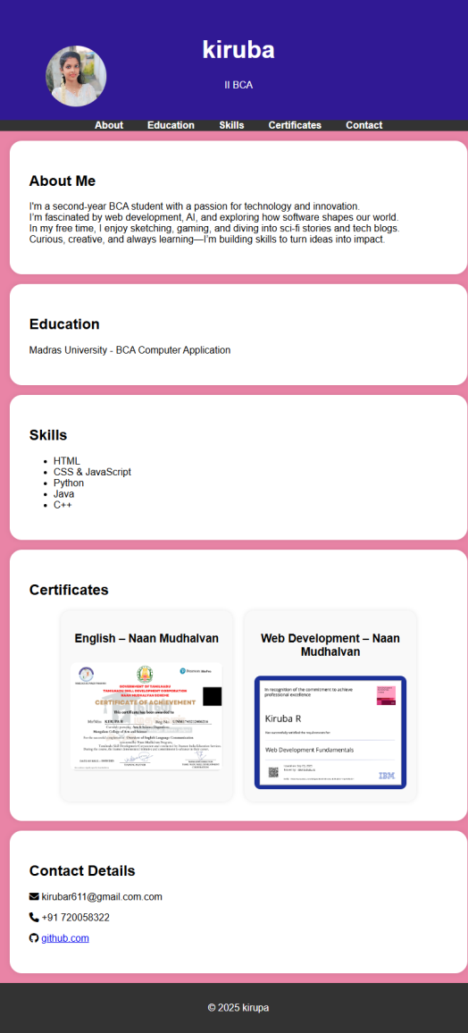
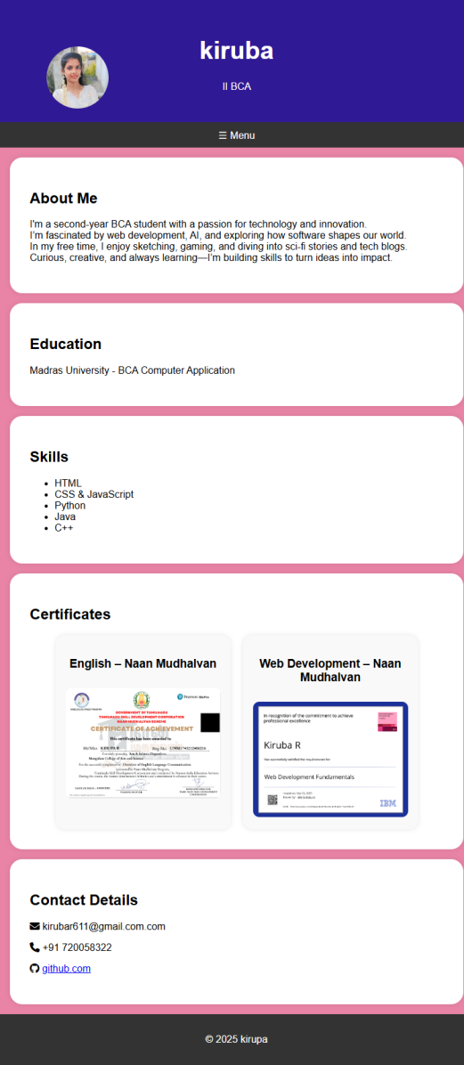
Results And Screenshots
Mobile view
Destop view

Slide 11
CONCLUSION
The project demonstrates a personal portfolio with sections like Home, About Me, Skills, Projects, and Contact. Its responsive design and interactive menu ensure smooth navigation. It reflects both creativity and technical growth.
My github link:https://kirubar611-hue.github.io/kiruba/

